Slide 1
Q2: build a pipeline that extract CSV file from postgressq and convert it to JSON then load it in MongoDB
1- Use docker compose to run the following images:
mongodb: to load the data
Apache Airflow: to build the pipeline
Postgresql: to extract CSV file
Jupyter/notebook: create CSV file by using faker library, write dags tasks
2- Save CSV file called data2 in the container and I renamed it to “data” which contains random data (faker library was used)
3- to run the container use these commands:
- git clone https://github.com/Danaestetieh/DE_Assigment1.git or download the folder
- docker-compose up command.
4- Use http://localhost:8080 to run Apche Airflow
5- Use http://localhost:8888 to run Jupyter notebook

Slide 2
Q2: build a pipeline that extract CSV file from postgressq and convert it to JSON then load it in MongoDB
1- Use docker compose to run the following images:
mongodb: to load the data
Apache Airflow: to build the pipeline
Postgresql: to extract CSV file
Jupyter/notebook: contains all codes
2- Save CSV file called data2 in the container and I renamed it to “data” which contains random data (faker library was used)
3- to run the container use these commands:
- git clone https://github.com/Danaestetieh/DE_Assigment1.git or download the folder
- docker-compose up command.
4- Use http://localhost:8080 to run Apche Airflow
5- Use http://localhost:8888 to run Jupyter notebook

Slide 3
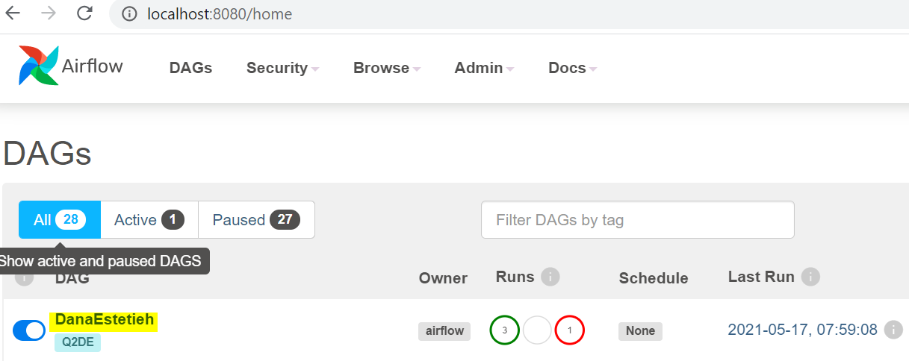
Airflow:
To run Airflow use this port: localhost:8080
The page has DAGs will be appeared

Slide 4


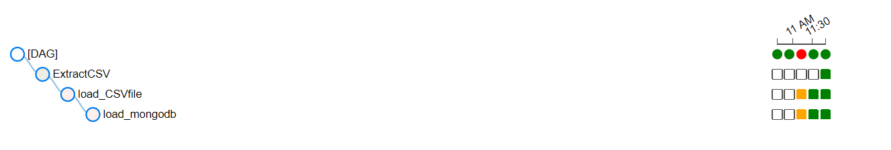
Airflow:
Click on the DAG name “DanaEstetieh”
Click on unpause button
Run the flow

Slide 6
Airflow:
- We have 3 tasks, extract CSV then convert it to JSON then load it to MongoDB

